Slide 1

Multiple Objectives
Professor Bo Liu
James Watt School of Engineering

Slide 2
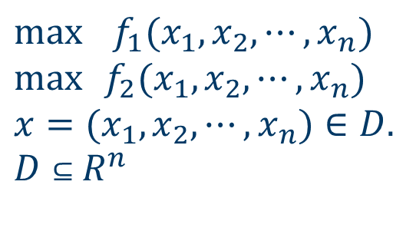
Multi-objective optimization
Bi-Objective Continuous Optimization Problem
$$\max{ } f_{1}(x_{1},x_{2},⋯,x_{n}) \\ \max{ }f_{2}(x_{1},x_{2},⋯,x_{n}) \\ x=(x_{1},x_{2},⋯,x_{n})∈D. \\ D⊆R^{n}$$
Minimization is similar
where x are the decision variables, D is the decision space.
Two objectives, f₁ and f₂, often conflict with each other.
How to measure the solution quality?

Slide 3
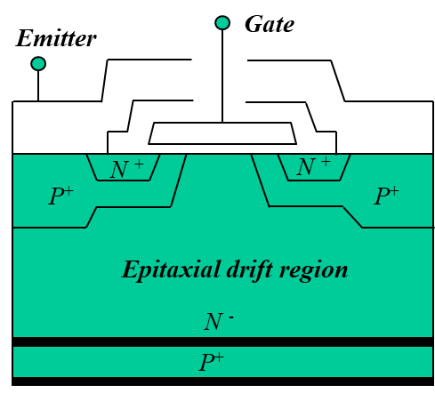
Multi-objective optimization: example
A multi-objective optimization problem
Example: design an insulated-gate bipolar transistor (IGBT) semiconductor controllable switch
  The failure rate should be as low as possible. The lower, the better.
  The cost should be as low as possible. The lower, the better.
  They conflict with each other.

Slide 4
Domination
Which solutions are optimal?
Domination:
x dominates y if
x is not worse than y in any objectives （ f(x) ≥f( y)）
x is strictly better than y in at least one objective （f(x)>f(y)）
Remarks:
For any two solutions, x, y.
x dominates y, or
y dominates x, or
x, y cannot be compared with each other.
f₁(x)
x₁
x₂
x₃
x₄
f₂(x)

Slide 5
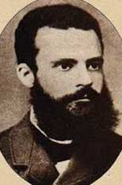
Pareto front
Which solutions are optimal?
Pareto front:
A collection of points without domination.
Pareto front
f₁
x
Dominated by x
y
Vilfredo Pareto (1848-1923)
f₂

Slide 6
Pareto-optimal solutions
Pareto Set (PS)
Pareto-Optimal Solution: Not dominated by any other solution
Pareto Set (PS): the set of all the Pareto optimal solutions (in the decision space).
Pareto-Optimal Front (PF): The objective function values of all the Pareto-optimal solutions.
PF=F(PS) (objective space)
Pareto front (PF)

Slide 7
Multi-objective constrained optimization
>1 objectives and >1 constraints can happen at the same time
Constrained multi-objective optimization
How to rank the solutions?
  Feasible solutions vs. Infeasible solutions
  Two feasible solutions: multi-objective
  Two infeasible solutions: constraint violations

Slide 8




Thanks!
#UofGWorldChangers
@UofGlasgow

